Slide 1
Hotel Booking & Cancellation Behaviour Analysis
Name :- AYUSH DASH
Data :- 11th August, 2026

Slide 2
Table of Contents
CONTENTS
01.
02.
03.
Executive Summary & Business Context
Data Foundation & Methodology
Demand & Seasonality Analysis
04.
05.
Cancellation Risk Analysis
Customer Insights & Strategic Recommendations

Slide 3
Executive Summary & Business Context
01

Slide 4

Project Overview
Purpose of the Analysis
This project examines hotel booking behaviour from 2017–2019 to uncover patterns in hotel type preference, seasonal demand, cancellation behaviour, stay duration, booking lead time, and revenue performance.
Core Analytical Dimensions
The study focuses on six key areas: hotel type preference, seasonal booking demand, cancellation behaviour, stay duration, booking lead time, and revenue/ADR patterns.

Slide 5

Key Findings at a Glance
Headline Statistics
Critical Risk Pattern
City Hotel accounts for 66.4% of all bookings, while the overall cancellation rate stands at 37.0%. The average booking lead time is 104 days, and October records the highest monthly booking volume.
Bookings made 180+ days in advance show approximately 57% cancellation, compared with only 9.6% for bookings made 0–7 days before arrival—a 47.4 percentage-point gap.

Slide 6


Business Problem Statement
01
Problem Definition
How can historical hotel booking data be used to understand demand patterns and identify booking characteristics associated with cancellation risk?
02
Why This Analysis Matters
Hotels need to understand customer booking behaviour to improve occupancy planning, revenue management, pricing decisions, staffing, inventory allocation, cancellation management, and customer retention.

Slide 7


Project Objectives
The project aims to analyze hotel booking demand, compare City Hotel and Resort Hotel performance, identify seasonal booking patterns, measure cancellation behaviour, and evaluate relationships between stay duration, lead time, and cancellation.
Analytical Goals
A data-driven hotel business analysis that converts booking data into actionable insights and strategic recommendations for hotel management.
Main Deliverable

Slide 8


Three Core Business Questions
01
02
Primary Questions
Supporting Questions
The project brief defines three primary questions: Which hotel type do customers book most often? Does length of stay affect cancellation rate? Does booking lead time affect cancellation rate?
Additional questions include: Which months generate the highest demand? Which hotel has the higher cancellation rate? Which booking segments are high-risk? How can cancellations be reduced?

Slide 9
Data Foundation & Methodology
02

Slide 10
Dataset Overview
Data Profile
Metric | Value
Records | 119,390
Original Columns | 29
Analysis Period | 2017–2019
Hotel Types | 2 (City & Resort)
Booking Status | Confirmed / Cancelled

Slide 11
Dataset Overview
Important Variables
Key variables include hotel, is_canceled, lead_time, arrival_date_year, arrival_date_month, stays_in_weekend_nights, stays_in_weekdays_nights, and adr.

Slide 12


Data Preparation
Data Quality Checks
Cleaning Approach
Quality checks covered missing values, duplicate records, undefined categorical values, negative ADR, extreme ADR values, and zero-guest bookings.
Missing categorical information was treated appropriately, unclear values were recategorized, exact duplicate records were removed, invalid ADR values were investigated, and zero-guest bookings were excluded from behavioural analysis.

Slide 13


Feature Engineering
Created Variables
Categorical Segmentation
New variables include Total Stay Nights (weekend + weekday), Total Guests (adults + children + babies), and Cancellation Status (cancelled/not cancelled).
Stay categories were defined as Short, Medium, and Long stays. Lead-time categories were segmented into 0–7 days, 8–30 days, 31–90 days, 91–180 days, and 181+ days.

Slide 14


Analytical Framework
1
Analysis Pipeline
The workflow progresses from raw booking data through data quality assessment, cleaning, feature engineering, exploratory analysis, demand analysis, cancellation analysis, and risk identification, culminating in business recommendations.
2
Analytical Dimensions
The analysis spans demand, seasonality, pricing, customers, and cancellation risk.

Slide 15
Demand & Seasonality Analysis
03

Slide 16


Hotel Booking Mix
Portfolio Distribution
Business Implication
City Hotel accounts for 66.4% of all bookings, while Resort Hotel represents 33.6%. City Hotel receives approximately two-thirds of all bookings, making it the dominant hotel type.
The two properties should not necessarily be managed using identical demand and marketing strategies given their substantially different booking volumes.

Slide 17
Booking Demand Trend
Annual Booking Volumes
Year | Bookings
2017 | 21,996
2018 | 56,707
2019 | 40,687

Slide 18

Booking Demand Trend
Key Insight
2018 records the highest booking volume in the analysis period, supporting capacity planning, staffing, promotional campaigns, and inventory management decisions.

Slide 19


Monthly Seasonality
Peak Demand Period
Business Preparation
October records 13,877 bookings, making it both the peak booking month and peak revenue month. Demand generally increases toward the second half of the year.
Hotels can prepare for peak periods through dynamic pricing, increased staffing, inventory planning, and targeted promotions.

Slide 20

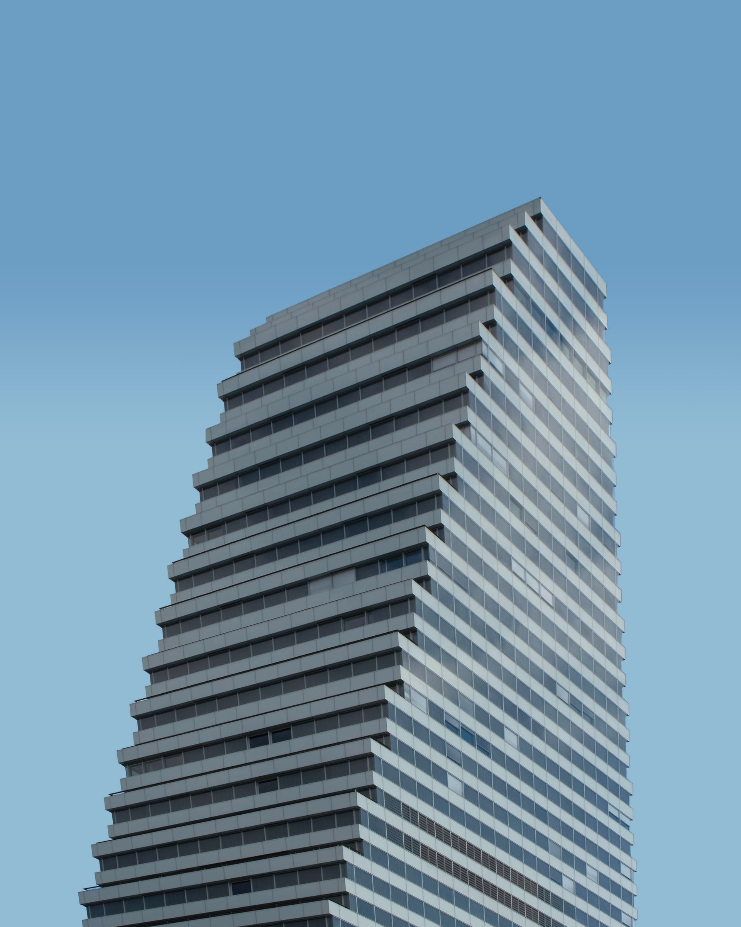
Revenue & Pricing Performance
Key Revenue Metrics
ADR Seasonality
Realized revenue totals $7.12M with an average ADR of $102. Revenue per booking is $95, and total room nights reach 110,746.
ADR increases significantly during the high-demand period, reaching approximately $140 in October, supporting demand-based pricing strategies during peak seasons.

Slide 21
City Hotel vs Resort Hotel Comparison
Performance Comparison
KPI | City Hotel | Resort Hotel
Bookings | 79,330 | 40,060
Confirmed | 46,228 | 28,938
Cancellations | 33,102 | 11,122
Revenue | ~$3.93M | ~$3.19M
ADR | $105.30 | $94.95
Cancellation Rate | 41.7% | 27.8%

Slide 22

City Hotel vs Resort Hotel Comparison
Key Insight
City Hotel leads in booking volume, revenue, and ADR, but also carries a significantly higher cancellation rate of 41.7% versus 27.8% for Resort Hotel.

Slide 23
Cancellation Risk Analysis
04

Slide 24


Cancellation Overview
Overall Cancellation Statistics
Business Impact
Of 119,390 total bookings, 44,224 were cancelled and 75,166 confirmed, yielding a 37.0% cancellation rate—more than one-third of all bookings.
A high cancellation rate creates uncertainty in occupancy, revenue forecasting, room inventory, staffing, and pricing decisions.

Slide 25



Cancellation by Hotel Type
Comparative Risk Profile
City Hotel shows a 41.7% cancellation rate versus 27.8% for Resort Hotel, a difference of 13.9 percentage points.
Strategic Recommendation
City Hotel should receive greater attention in cancellation policy design, booking confirmation, deposit strategies, and overbooking/risk planning.

Slide 26
Stay Duration Analysis
Analytical Approach
Cancellation rates are compared across short, medium, and long stay segments, assessed separately for City and Resort Hotels due to their differing overall cancellation profiles.
Presentation Note
The relationship between stay duration and cancellation should be presented strictly according to what the visualization demonstrates, without overstating causal claims.

Slide 27
Lead Time as a Cancellation Risk Indicator
Cancellation Rate by Lead Time
Lead Time | Cancellation Rate
0–7 Days | 9.6%
8–30 Days | 27.9%
31–90 Days | 37.7%
91–180 Days | 44.7%
180+ Days | 57.0%

Slide 28

Lead Time as a Cancellation Risk Indicator
Key Finding
Cancellation risk increases sharply as the booking is made further in advance, making lead time one of the strongest cancellation predictors in the dataset.

Slide 29
Far-Ahead Bookings: Highest Risk Segment
Risk Escalation
The cancellation rate rises from 9.6% to 57.0% between the shortest and longest lead-time groups—a 47.4 percentage-point increase.
Business Interpretation
Customers making reservations far ahead may have greater uncertainty about travel plans, more opportunities to change plans, flexible cancellation conditions, or multiple alternative bookings.

Slide 30
Deposit Policy & Cancellation Risk
Cancellation Rate by Deposit Type
The dataset shows approximately 28% cancellation for No Deposit bookings, ~100% for Non Refund, and ~22% for Refundable bookings.
Professional Interpretation
The Non Refund ≈100% result should be presented as an unusually high cancellation rate requiring further investigation before changing policy, rather than claiming causation.

Slide 31
Customer Insights & Strategic Recommendations
05

Slide 32
Booking Channels & Market Segments
Channel Distribution
Online TA is the largest market segment, with TA/TO dominating at approximately 82% of bookings, indicating heavy dependence on intermediary channels.
Channel Optimization
Management should compare channels using booking volume, revenue, cancellation rate, and customer value to optimize the channel mix rather than focusing only on volume.

Slide 33
Customer Behaviour Profile
Customer Demographics
Total guests reach 234,988 with an average of 2.0 guests per booking. Repeat guests number 3,810, representing only a 3.2% repeat guest rate.
Retention Opportunity
The customer base is heavily weighted toward new rather than repeat guests, indicating potential to improve loyalty, repeat bookings, customer retention, and direct booking behaviour.

Slide 34

Key Business Insights
Six Core Learnings
City Hotel dominates bookings at 66.4%. Overall cancellation rate is 37.0%. City Hotel has a higher cancellation rate at 41.7%. October is the peak booking month with 13,877 bookings. Cancellation increases dramatically with longer lead time. Only 3.2% of bookings are from repeat guests.

Slide 35
Recommended Actions
Strategic Recommendations
Implement dynamic pricing during high-demand periods such as September–October. Strengthen cancellation management, particularly for City Hotel. Manage far-ahead bookings with confirmation reminders, deposit requirements, rescheduling options, and targeted retention communication.
Additional Actions
Optimize distribution channels based on both revenue and cancellation behaviour. Build customer loyalty through campaigns designed to increase the low repeat-guest rate.

Slide 36
Conclusion
Main Takeaways
Hotel performance is strongly connected to booking mix, seasonality, and cancellation behaviour. City Hotel is the dominant booking segment, cancellation risk increases significantly with longer lead times, and seasonal demand creates opportunities for dynamic pricing.
Biggest Business Opportunity
Proactively manage high-risk, far-ahead bookings while aligning pricing and resources with seasonal demand patterns.

Slide 37
Thank You

